Slide 1
Full-waveform adjoint CMT Inversion : Synthetic Case
Azhar Harisandi
Advisors :
Dr. rer. nat. David P. Sahara
Dr. rer. nat. Andri Hendriyana
Faculty of Mining and Petroleum Engineering
Department of Geophysical Engineering

Slide 2
Outline
Full Waveform Inversion technology
Forward and Adjoint simulation
Preliminary results of CMT Inversion

Slide 3
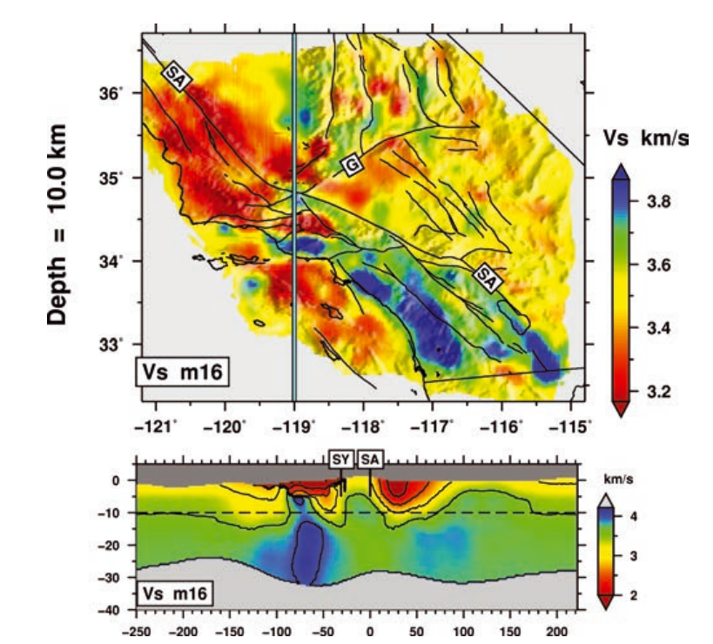
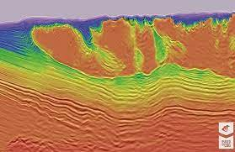
Full Waveform Inversion
CGG
Tape et al (2010)

Slide 4
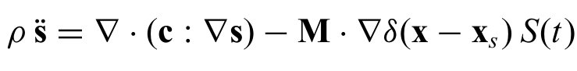
Inversion Flowchart
Model
Update model parameters
Forward Modeling
No
Fit?
Synthetic data
Data
Yes
Best solution (given available data)

Slide 5
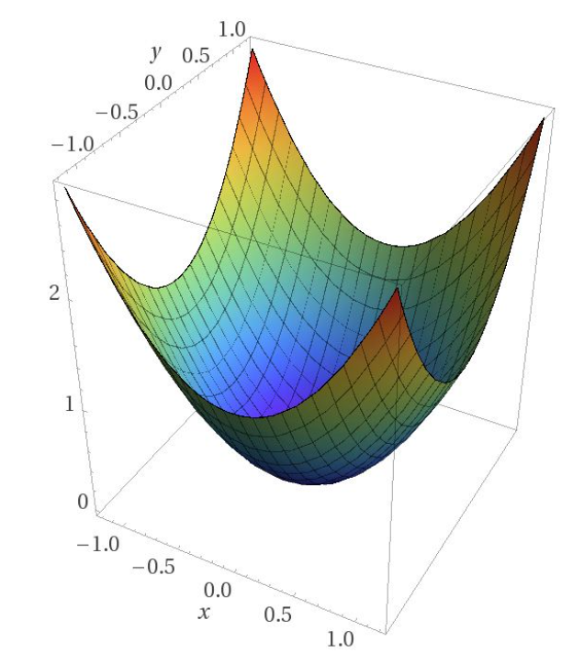
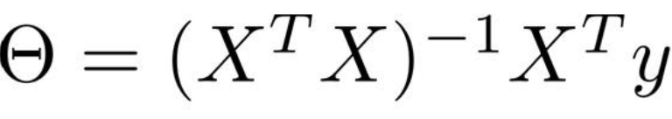

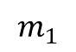
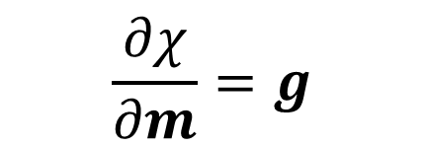
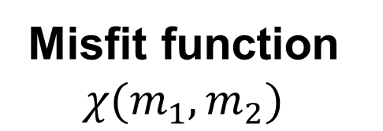
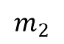
Optimization method
Misfit function $χ(m_{1},m_{2})$
Gradient (steepest ascent)
-Gradient (steepest descent)
Linear forward problem
$$m_{2}$$
$$m_{1}$$
$$\frac{∂χ}{∂m}=g$$
$$m^{i+1}=m^{i}−αg$$

Slide 6
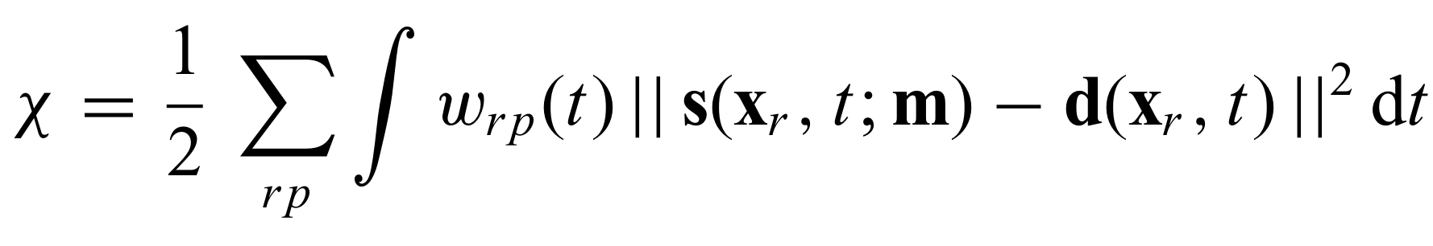
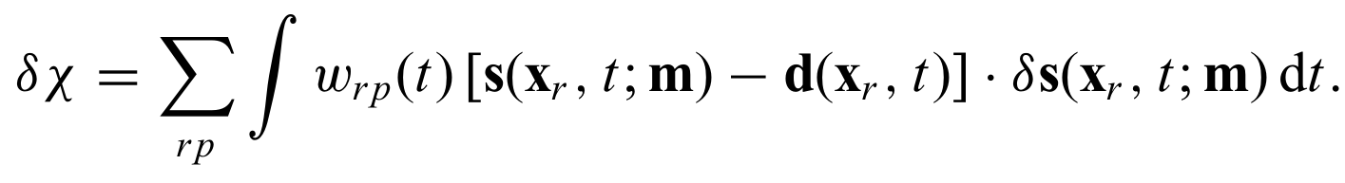
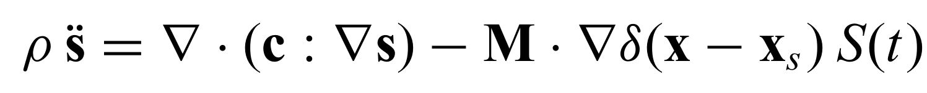
Misfit functional
Waveform misfit :
Synthetic waveform
Observed waveform
Derivative of misfit functional
displacement
?
density
Elastic modulus
Source

Slide 7
Adjoint state method
Method to calculate gradient of misfit functional with respect to model parameters
Take variation of misfit functional with respect to desired parameters
Define adjoint source
Run Adjoint simulation
Adjoint wavefield
Define misfit functional

Slide 8
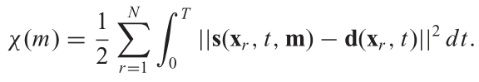
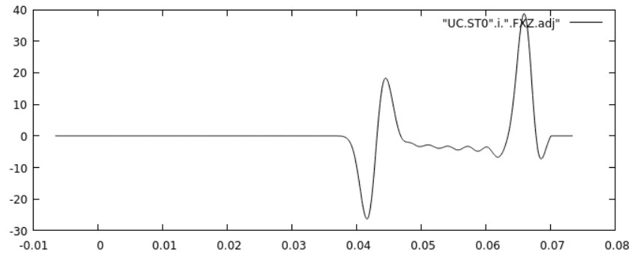
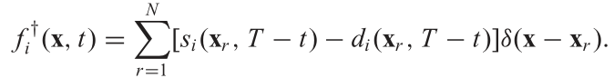
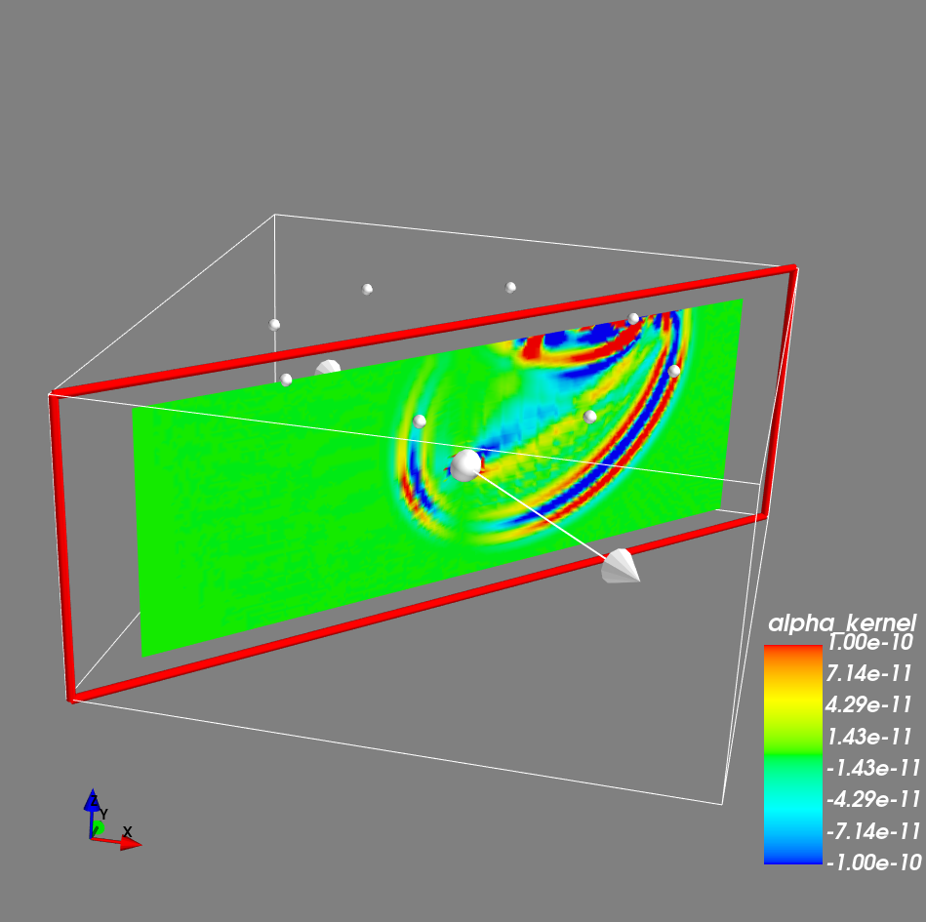
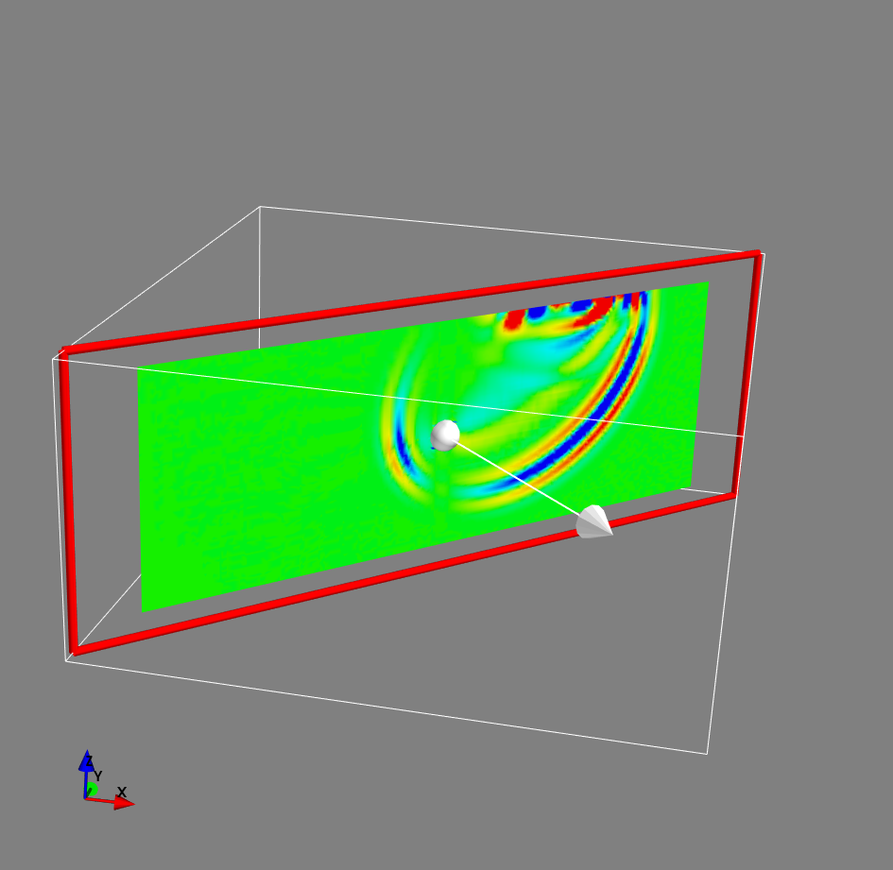
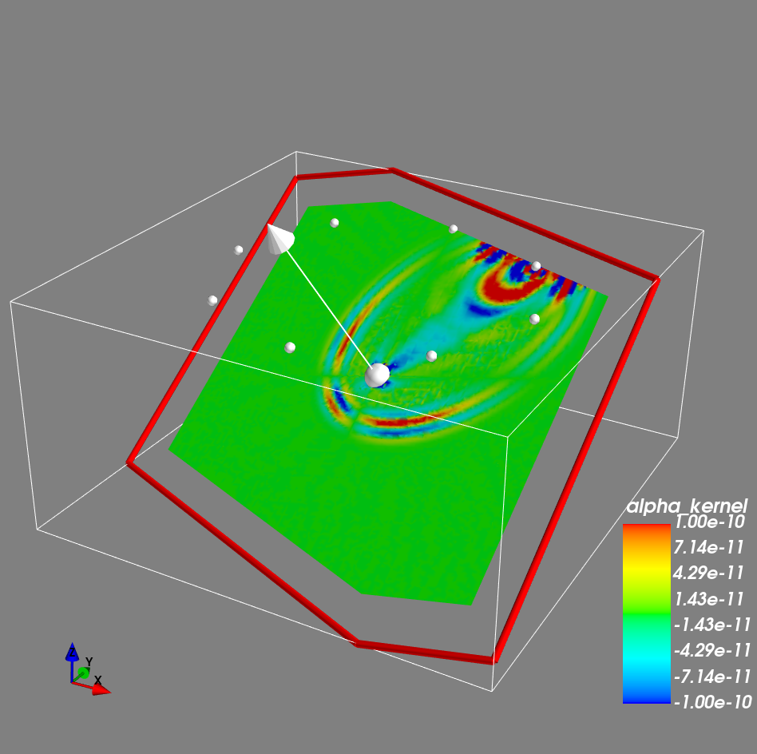
Kernel Gallery (elastic parameter kernel)
Synthetic
waveform
Actual waveform
Adjoint source

Slide 9
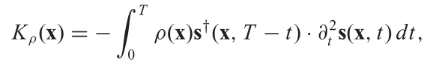
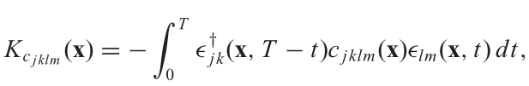
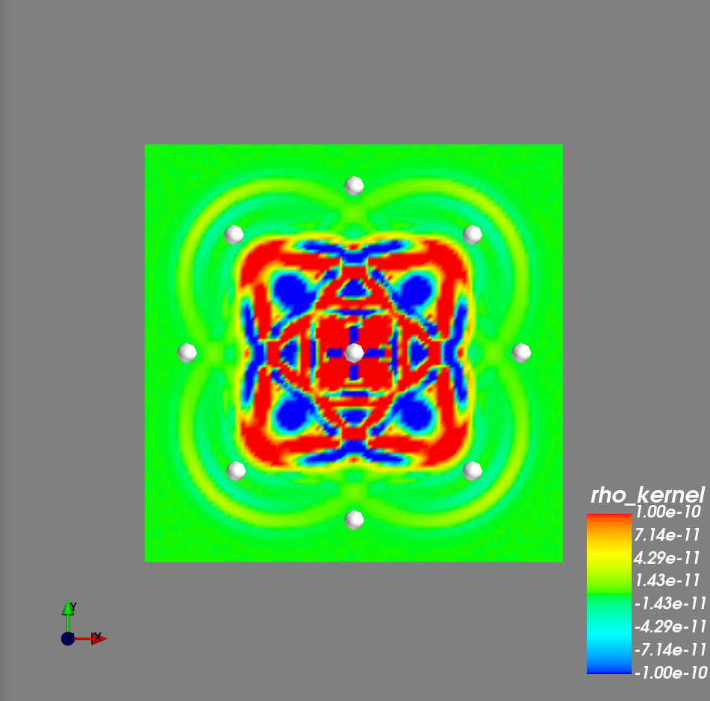
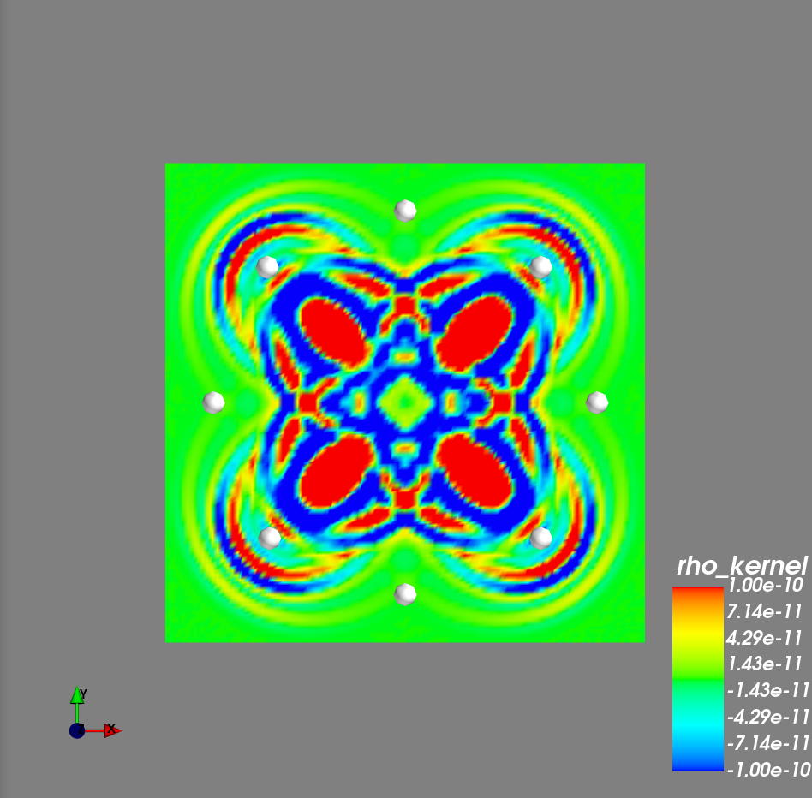
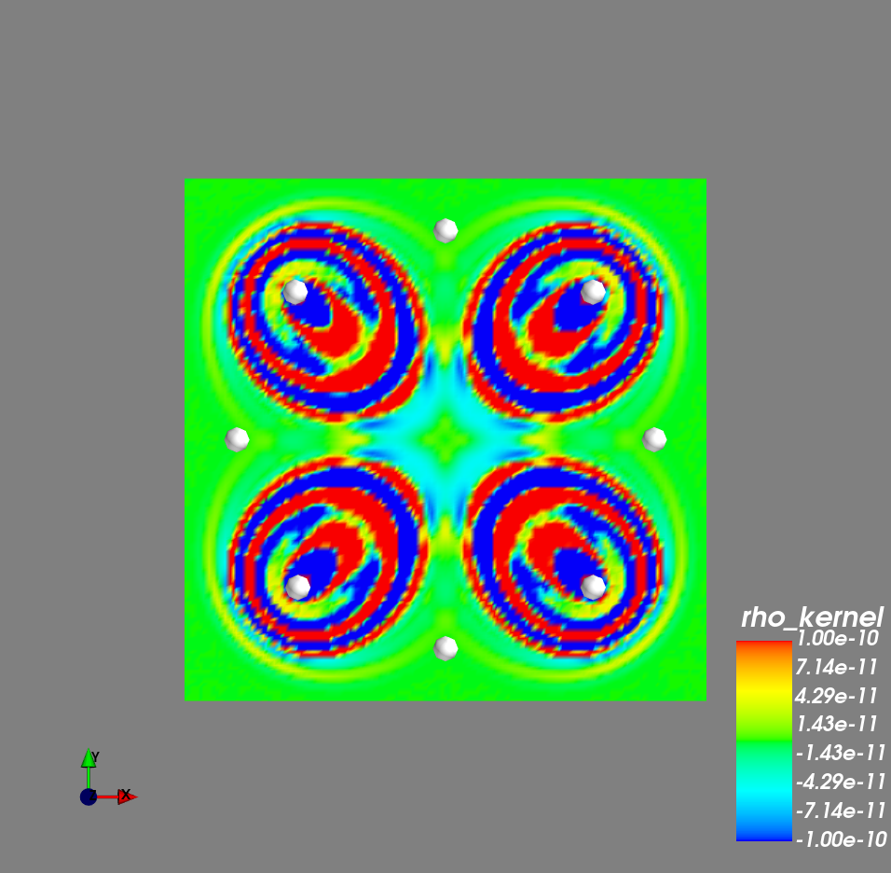
Kernel Gallery (depth slice)
Alpha kernel
Beta kernel
Rho kernel

Slide 10
Preliminary Results

Slide 11
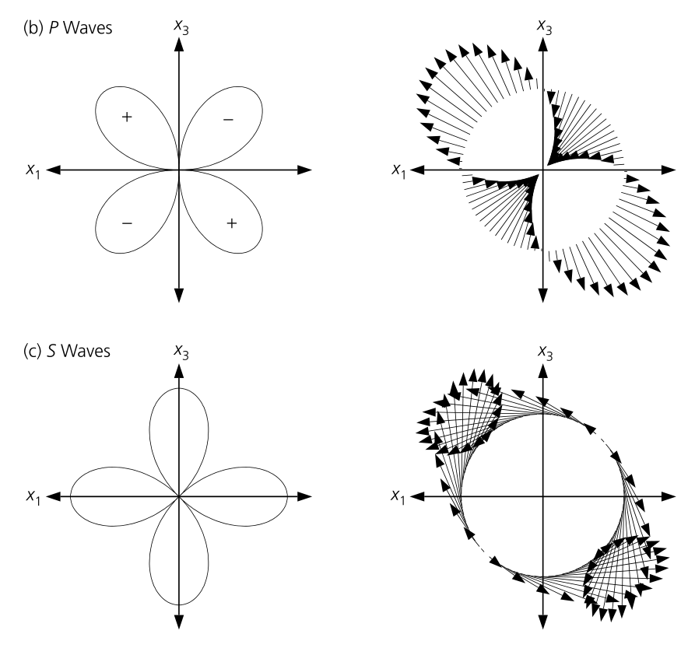
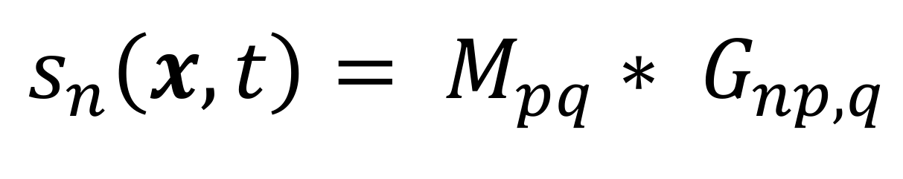
Adjoint CMT Inversion
Moment Tensor
Contains equivalent body force radiated from a point source that gives The same radiation pattern compared to the one coming from dislocation source.
Stein & Wysession (2003)

Slide 12
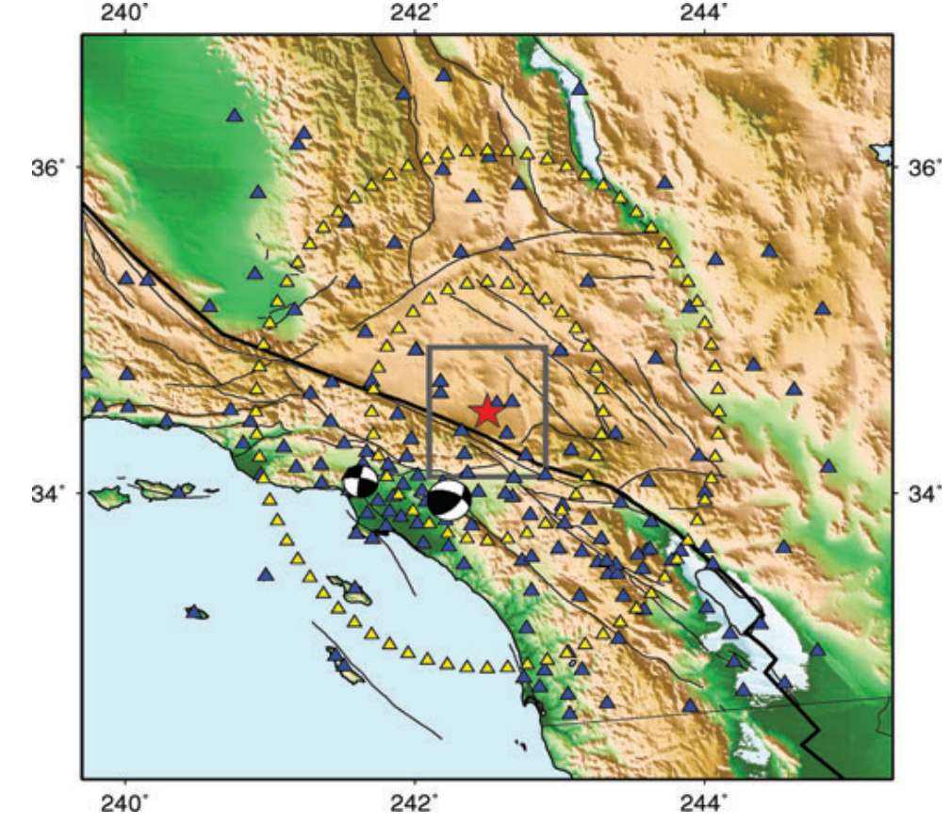
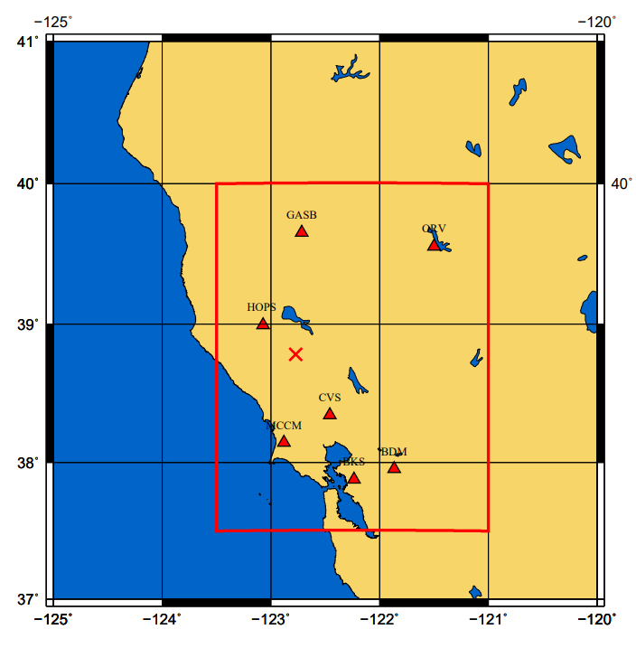
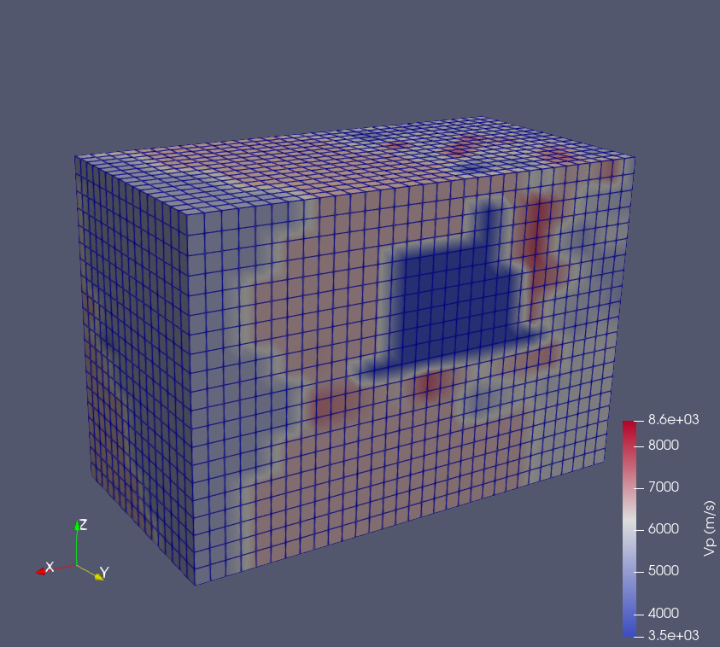
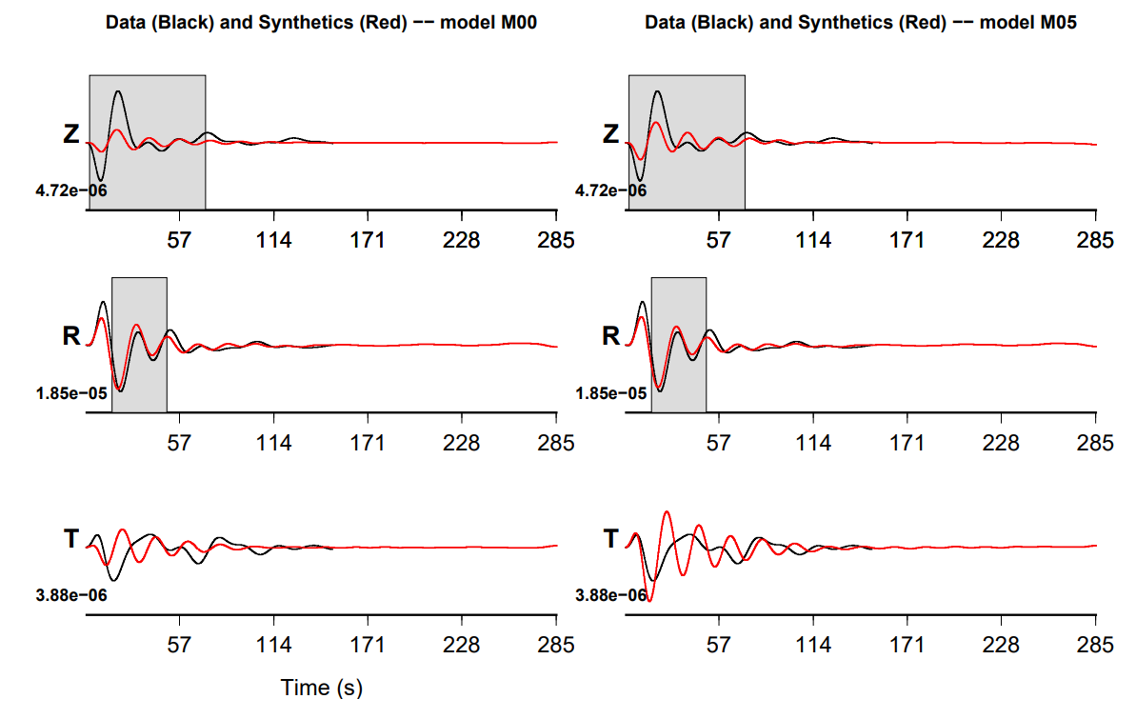
Adjoint CMT Inversion
Previous publications
Our case
Southern California Earthquakes
Kim et al., (2011)
Underground mining activity
Heterogeneous earth model
Anthropogenic earthquake
Geyser geothermal field,
Northern California
Morency, C., & Mellors, R. (2012)

Slide 13
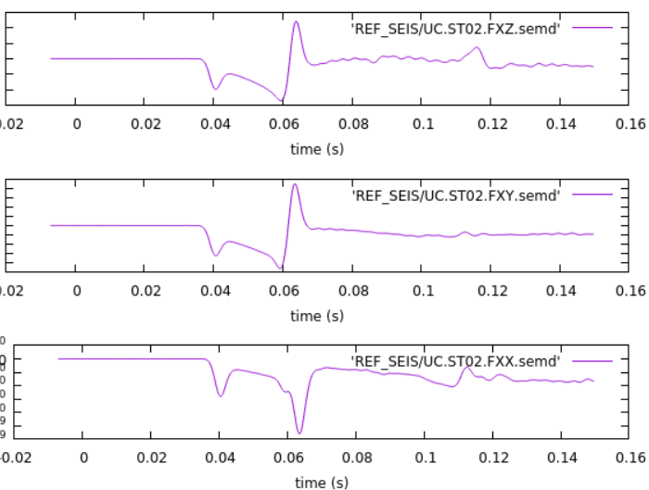
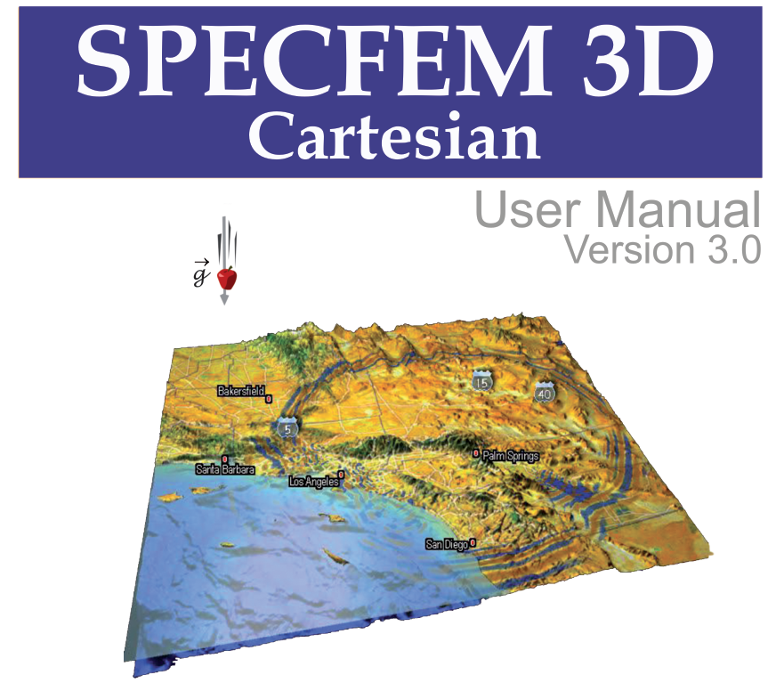

Green’s function calculation in 3D
Numerical solver
(Spectral-element method)
Models :
Source parameters
Earth model
Forward problem

Slide 14
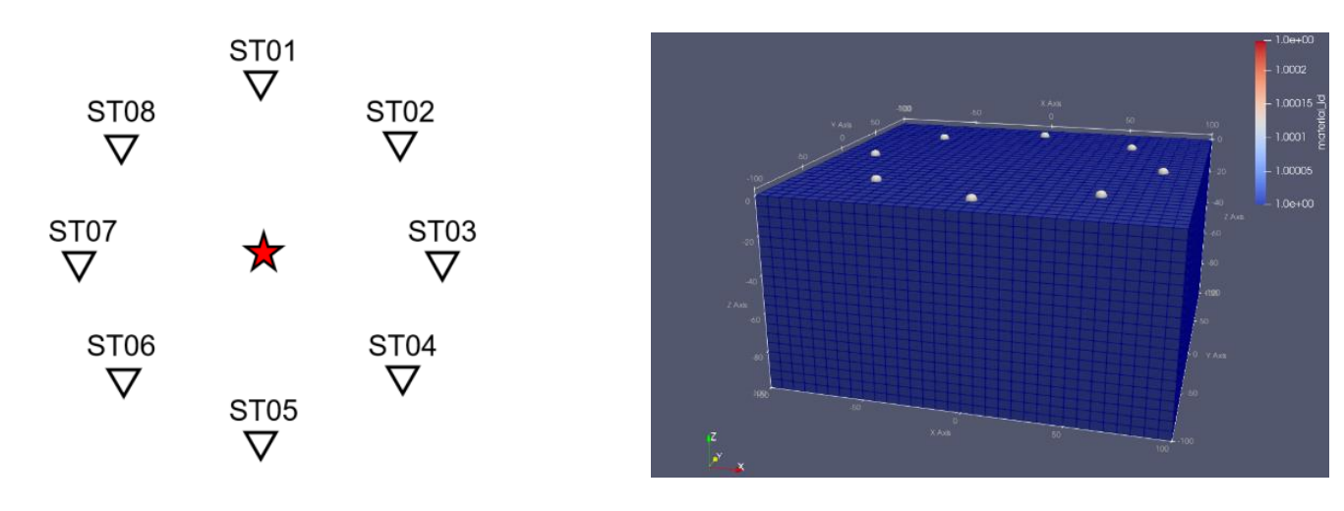
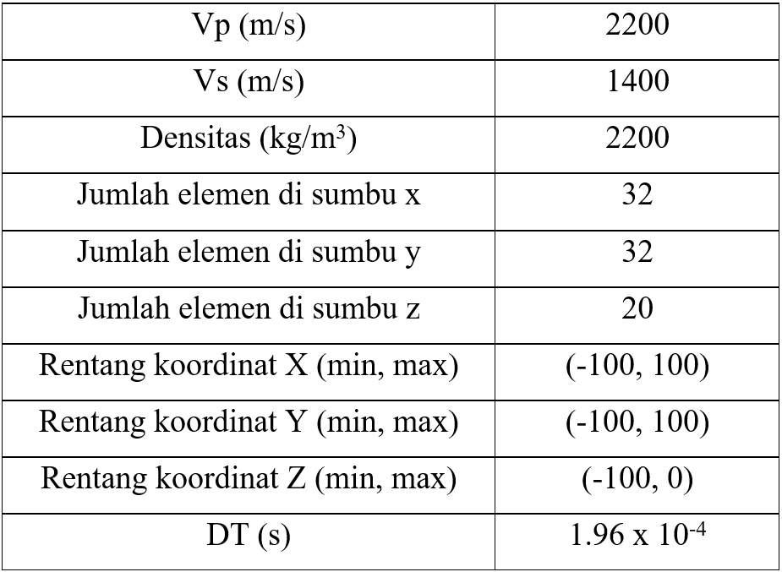
Simulation parameters
source-receiver geometry
3D mesh
Density (kg/m³)
No. of elements in x axis
No. of elements in y axis
No. of elements in z axis
X coordinate range (min, max)
Y coordinate range (min, max)
Z coordinate range (min, max)

Slide 15
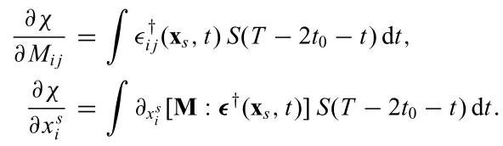
Adjoint Method
Regular wave equation :
Adjoint wave equation :
regular wavefield
Moment tensor and source parameters
Adjoint wavefield
Adjoint source
Kim (2011)

Slide 16
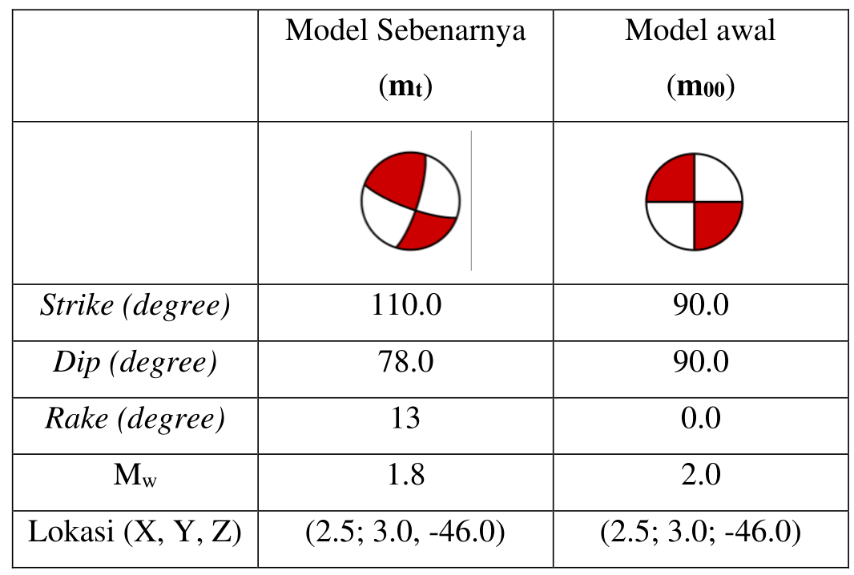
6 Parameters Moment-Tensor Inversion
True Model
Initial Model
Loc (X, Y, Z)

Slide 17
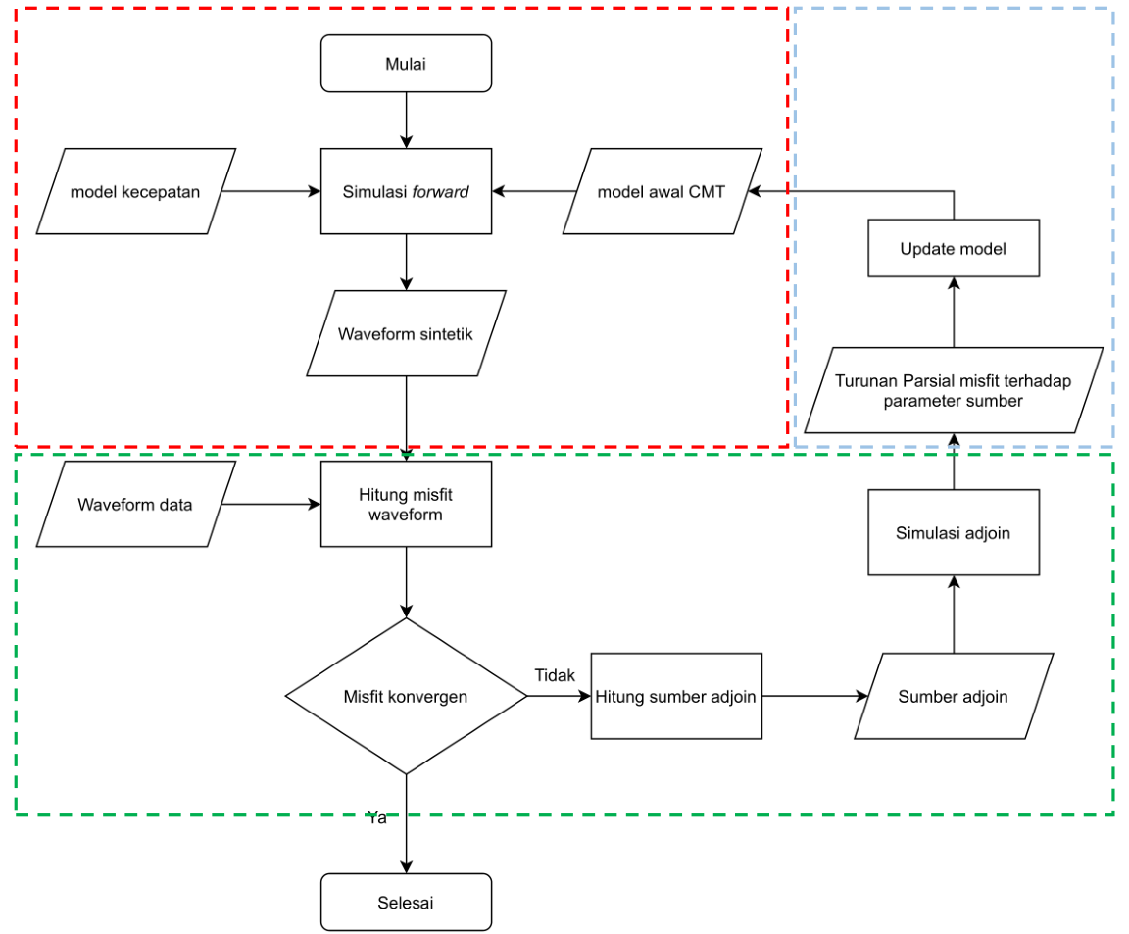
Inversion flowchart
Start
Model Update
Earth model
Forward Simulation
Source model
Update model
Forward Simulation
Synthetic Waveform
Misfit gradient
Observed Waveform
Calculate waveform misfit
Adjoint simulation
No
Create adjoint source
Adjoint source
Adjoint Simulation
Good fit?
Yes
Finish

Slide 18
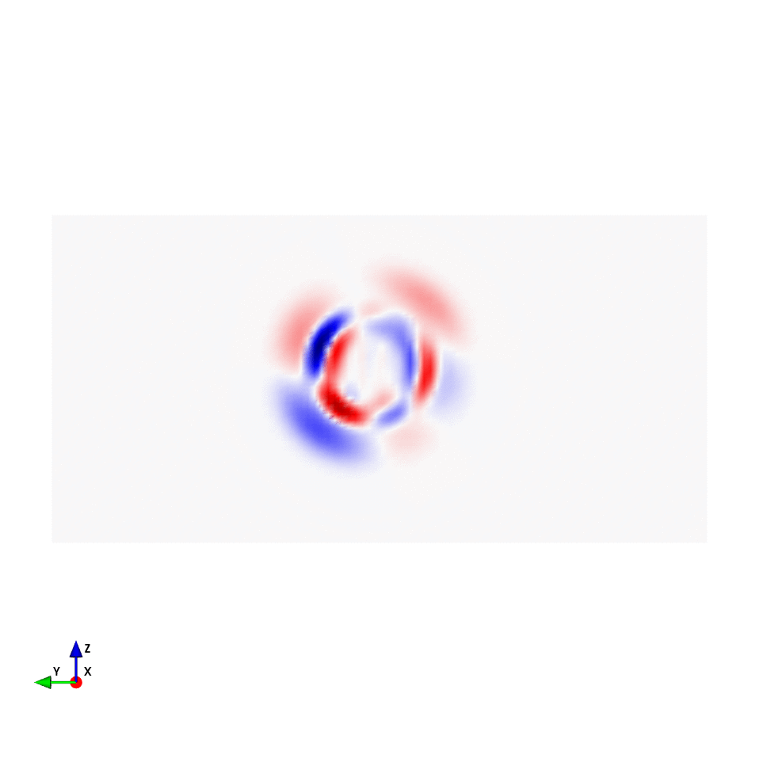
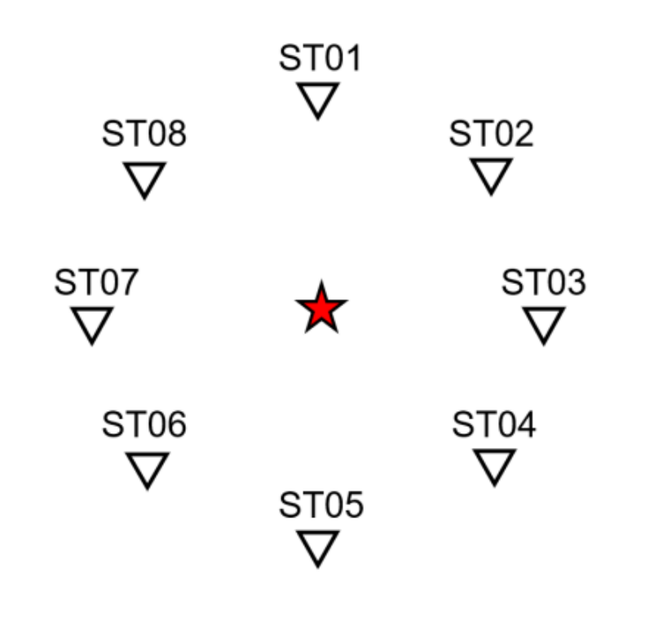
Forward Simulation
ST01
ST05
(Vertical component of velocity wavefield)

Slide 19
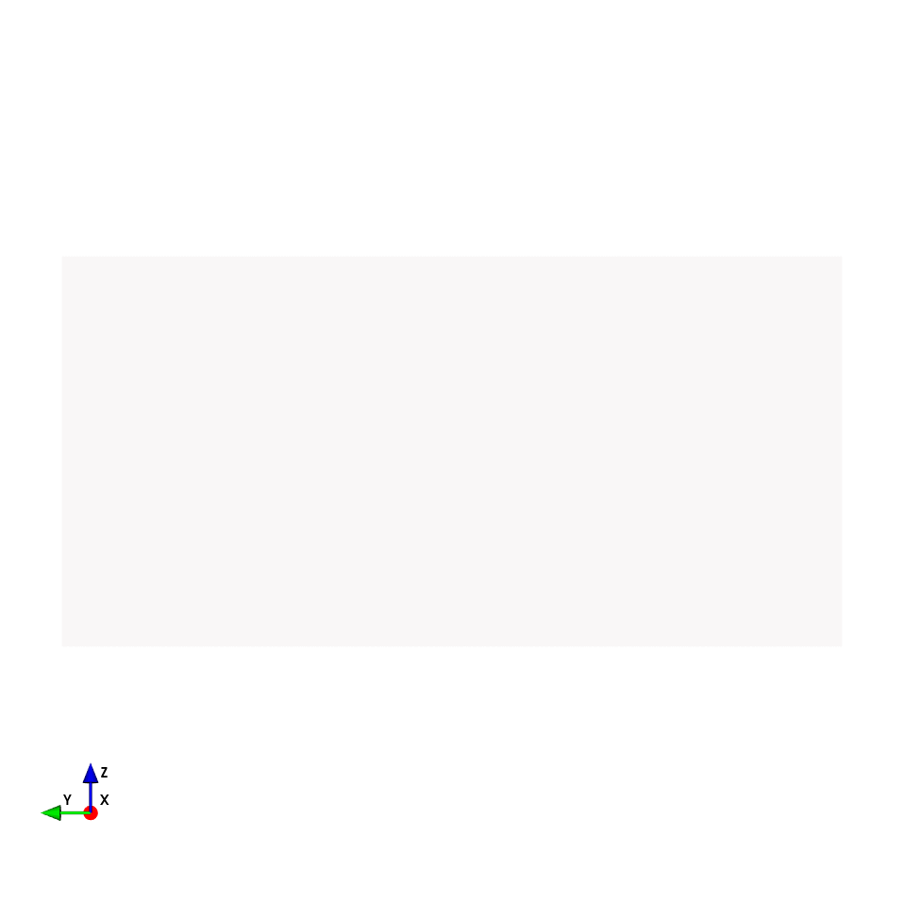
Adjoint Simulation
ST01
ST05
(Vertical component of velocity wavefield)

Slide 20
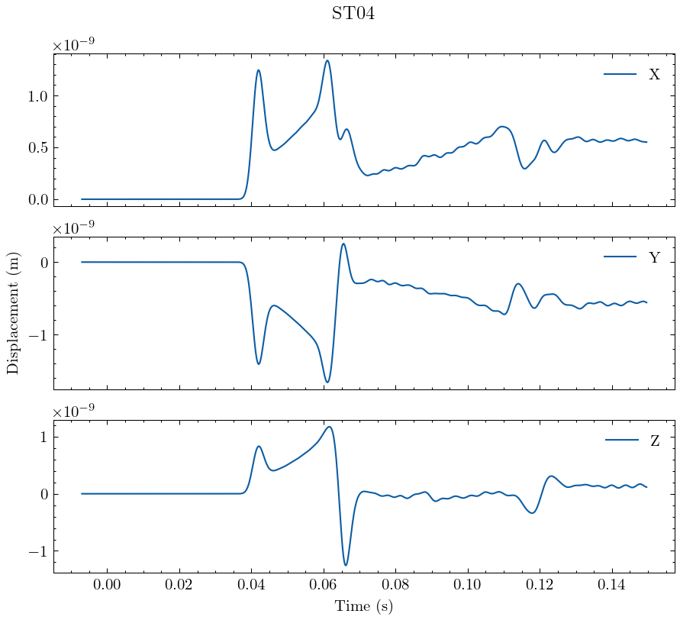
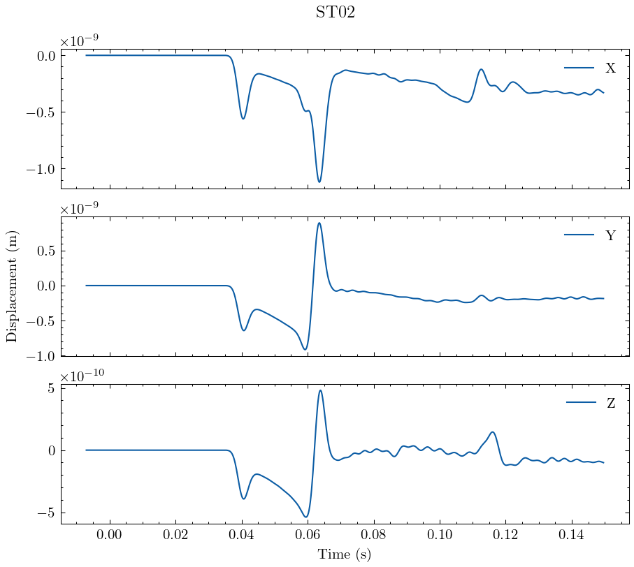
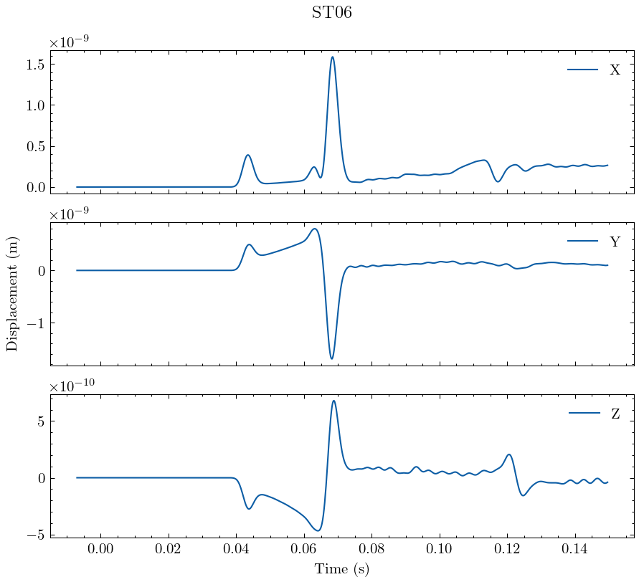
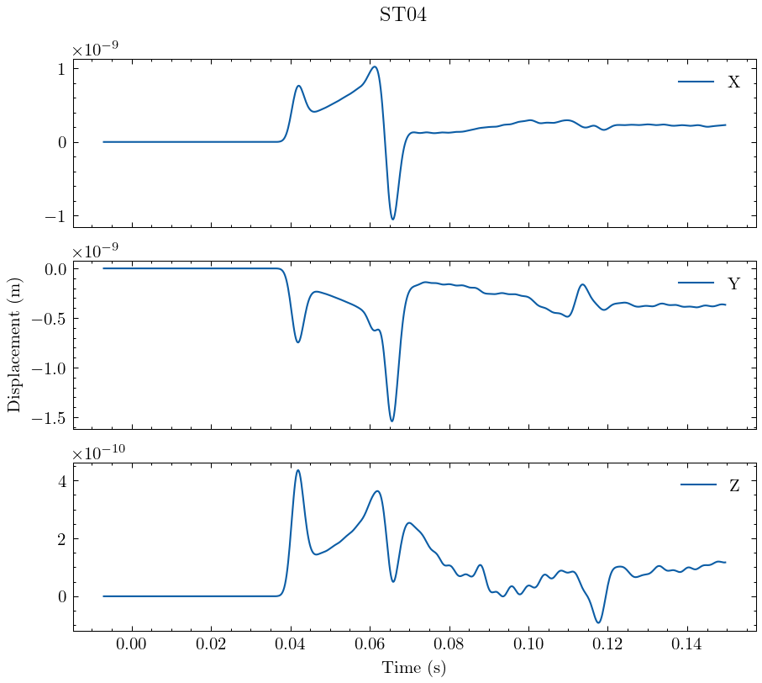
Simulated seismogram (True data)
ST08
ST02
ST06
ST04

Slide 21
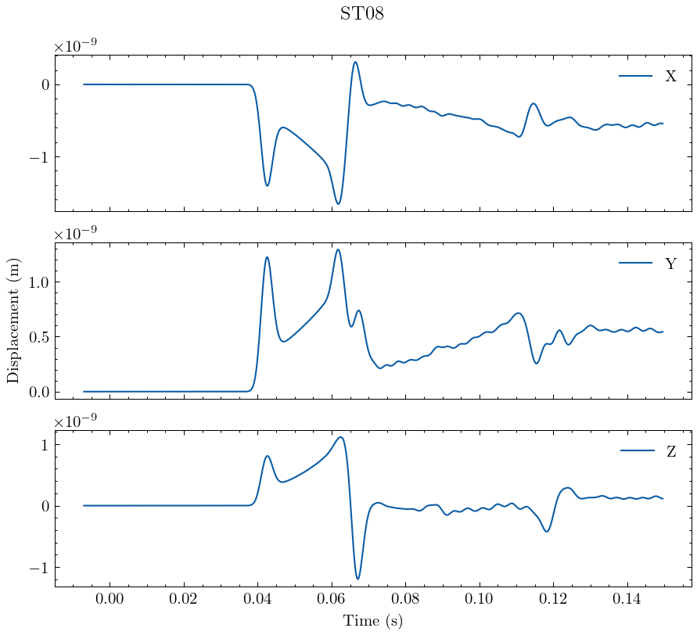
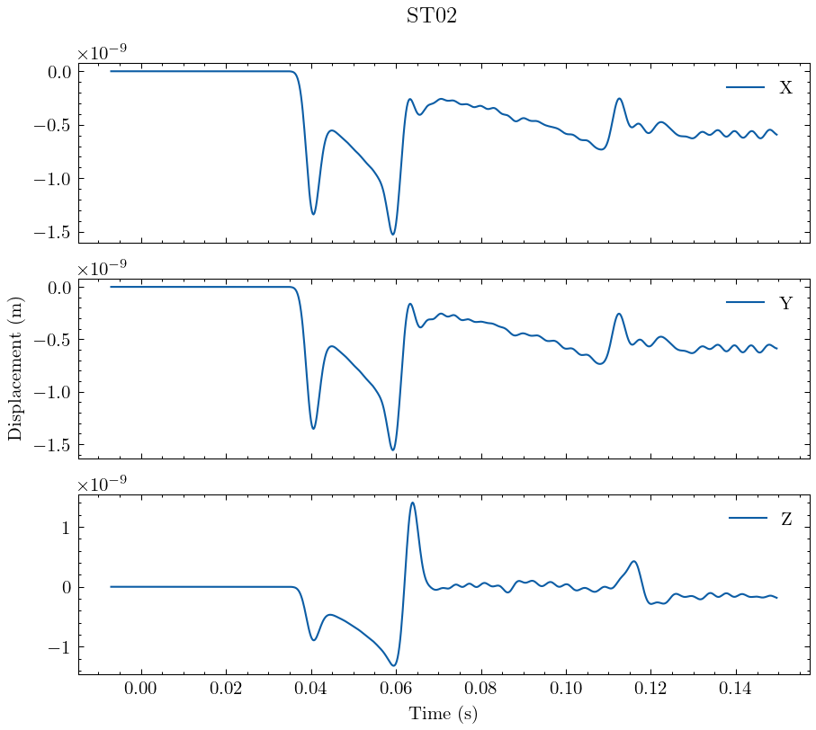
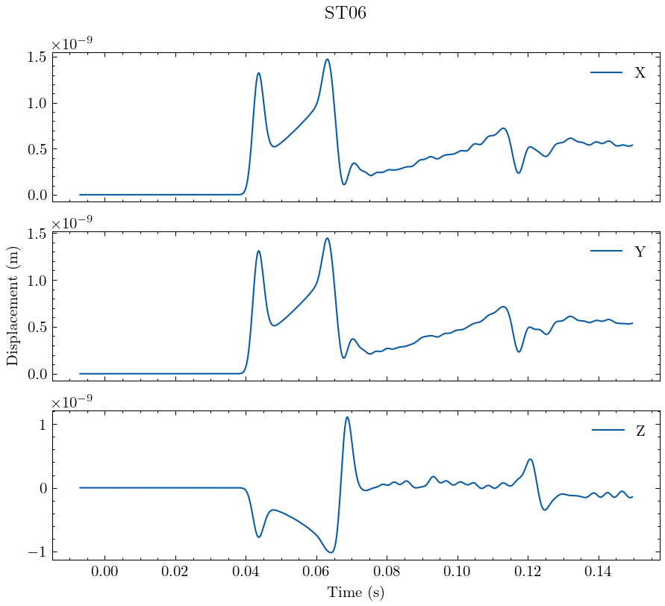
Simulated seismogram (Initial model)
ST08
ST02
ST06
ST04

Slide 22
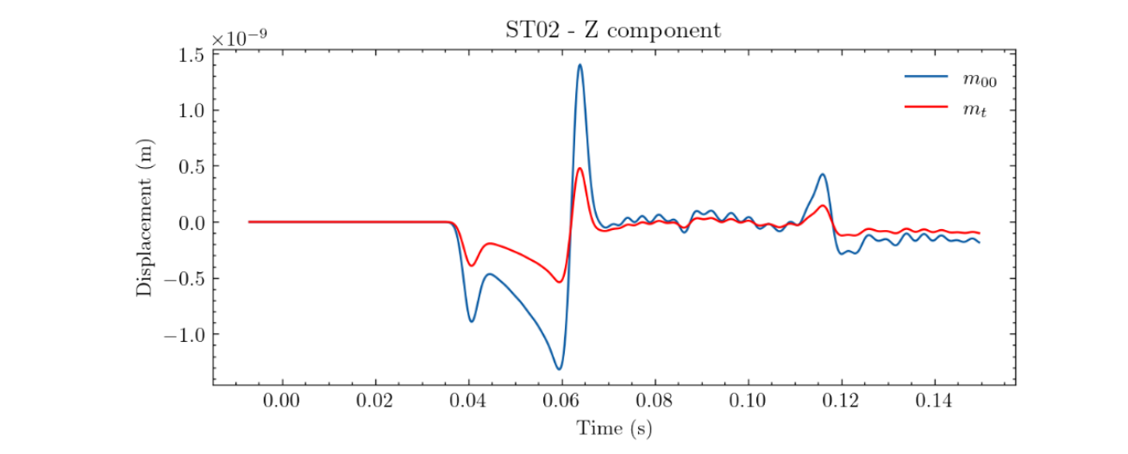
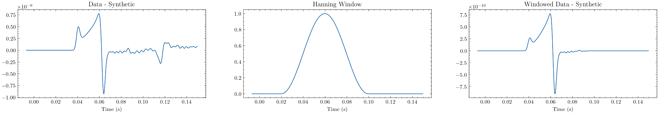
Adjoint source

Slide 23
Adjoint source

Slide 24

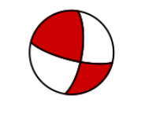
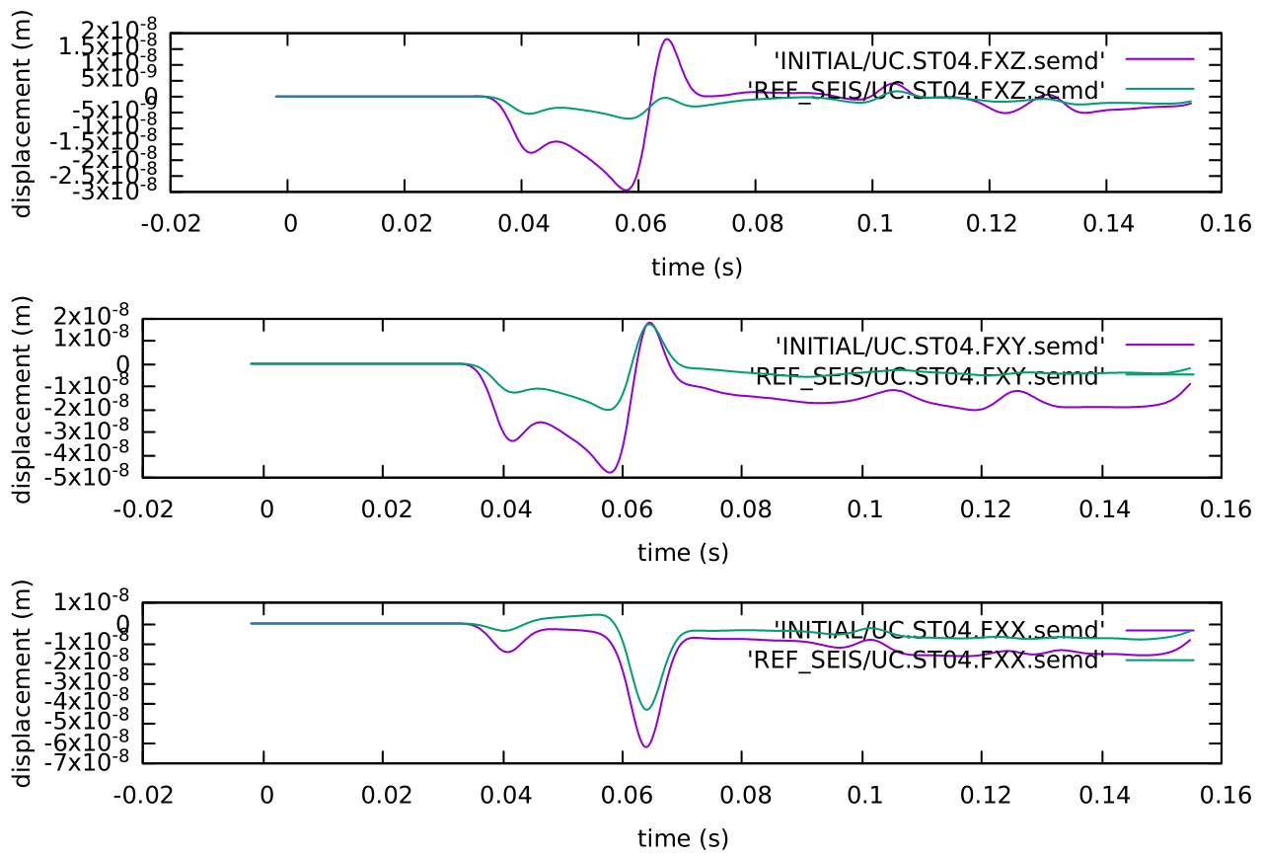

 | True Model : m_{t} | Initial model : m₀₀ | Best model : m₀₃
(strike 1, dip 1, rake 1) | (110, 78, 13) | (90, 90, 0) | (104.1, 75.6, 21)
(strike 2, dip 2, rake 2) | (17.3, 77.3, 167.7) | (0, 90, 180) | (8.7, 69.7, 164.6)
Mw | 1.8 | 2.0 | 1.92
Initial seismogram (purple) vs Reference seismogram (green)
Best model seismogram (purple) vs Reference seismogram (green)
NS
component
EW
component
UD
component

Slide 25
Discussion
Misfit gradients with respect to source coordinates do not vanish even though the source location is correct, because it also depends on the errors in the moment tensor elements. In this trial, we explicitly assign the gradient with respect to source locations to be zero.
It is required to have a reasonably good starting model, the options are using

Slide 26




Future Works

Slide 27
References
Aki, K., & Richards, P. G. (2002): Quantitative Seismology. Sausalito, Calif : University Science Books.
Ambara P., IP Raditya. (2020): Analisis Evolusi Struktur Vp, Vs, dan Vp/Vs melalui Tomografi 4D pada Lapangan Pertambangan Bawah Tanah “UC”, Tesis Program Magister, Institut Teknologi Bandung.
Chodacki, J. (2020): Simulation of ground motion in a polish coal mine using spectral-element method. Journal of Seismology, 24(2), 363–373.
Fichtner, A. (2010): Full Seismic Waveform Modelling and Inversion (Advances in Geophysical and Environmental Mechanics and Mathematics) (2011th ed.).
Fletcher, R., (1987): Practical Methods of Optimization, 2nd edn, John Wiley & Sons, New York, NY
FP. (2018): Introduction to Microseismic in “UC” mine, internal report.
Gharti, H. N., Oye, V., Kühn, D., & Zhao, P. (2011): Simultaneous microearthquake location and moment‐tensor estimation using time‐reversal imaging. SEG Technical Program Expanded Abstracts 2011, 1632–1637.
Kawakatsu, H., & Montagner, J. P. (2008): Time-reversal seismic-source imaging and moment-tensor inversion. Geophysical Journal International, 175(2), 686–688.
Kim, Y., Liu, Q., & Tromp, J. (2011): Adjoint centroid-moment tensor inversions. Geophysical Journal International, 186(1), 264–278.
Komatitsch, D., & Tromp, J. (1999): Introduction to the spectral element method for three-dimensional seismic wave propagation. Geophysical Journal International, 139(3), 806–822.

Slide 28
References
Liu, Q. (2004): Spectral-Element Moment Tensor Inversions for Earthquakes in Southern California. Bulletin of the Seismological Society of America, 94(5), 1748–1761.
Modrak, R., & Tromp, J. (2016): Seismic waveform inversion best practices: regional, global and exploration test cases. Geophysical Journal International, 206(3), 1864–1889.
Morency, C., & Mellors, R. (2012): Full moment tensor and source location inversion based on full waveform adjoint inversion: application at the Geysers geothermal field. SEG Technical Program Expanded Abstracts.
Tape, C., Liu, Q., Maggi, A., & Tromp, J. (2010): Seismic tomography of the southern California crust based on spectral-element and adjoint methods. Geophysical Journal International, 180(1), 433–462.
Tape, C., Liu, Q. and Tromp, J. (2007), Finite-frequency tomography using adjoint methods—Methodology and examples using membrane surface waves. Geophysical Journal International, 168: 1105-1129.
Tromp, J., Tape, C., & Liu, Q. (2004): Seismic tomography, adjoint methods, time reversal and banana-doughnut kernels. Geophysical Journal International, 160(1), 195–216.

Slide 29
Thank you

Slide 30
Backups

Slide 31








Adjoint method
1
Variation with respect to structural parameter
Variation with respect to source parameter
Adjoint source
Adjoint source
1
1
31

Slide 32
Adjoint simulation vs Forward simulation
Regular forward simulation
Solve wavefield
regular wavefield
Create seismic source
Adjoint simulation
Create adjoint source
Solve wavefield (receiver as virtual source)
Adjoint wavefield

Slide 33


Slide 34


Slide 35



Waveform kernel

Slide 36






Adjoint Method philosophy

Slide 37








Slide 38

Iteration 6

Slide 39


Slide 40


With PML
Without PML

